Slide 1
DLBCSPJWD01-Project Java Web Development
Name: Huseyin
Lastname: Ozdogan
Marticulation No: 92111877
Project Github Link: https://github.com/Dan88Hus/hdo.git
Project Deployed Link: https://pjwd01.herokuapp.com/

Slide 2
Purpose of web application
HDO is a fictional company and wants to introduce the company to public web users
The Company owner wants to use the application for marketing reasons to display past project pictures and potential customers can contact the company by email directly on the application.

Slide 3
Textual solution to past project pictures to be displayed
Company owner is not satisfied to update the website frequently, to develop a more effective application, it must fetch past project pictures dynamically.
To solve the issue, a media-server is used which is called Cloudinary .
Cloudinary makes easy to upload pictures like social media (Instagram) and web-application will fetch uploaded pictures to display, so web-application does not need to be updated frequently.

Slide 4
Textual solution to make-able application user directly sends email
The Company owner wants potential customers can able to communicate with the company e-mail on the application
To solve the issue, an SMTP (Simple Mail Transfer Protocol) provider is used which is called Sendgrid.
Sendgrid sends email by using a verified mail address, in this project a Gmail free account is used as the verified sender.

Slide 5
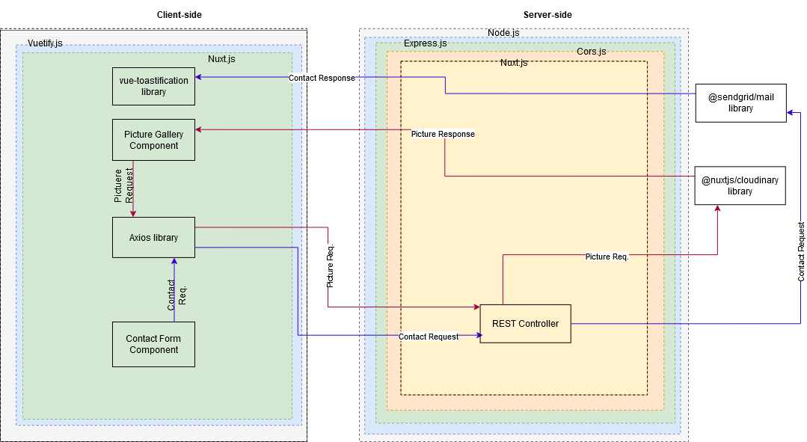
Architectural Diagram of solution

Slide 6
Overview of technology choices for front-end and back-end
JavaScript technologies are used for the front-end and back-end development of the project.
CSS (Cascading style sheet) framework is used to write clean code as it is component-based which is called Vuetify and Bootstrap is used and it is class-based CSS library.
Node.js for the server-side and JavaScript framework for the front-end which is named Nuxt.js Nuxt.js is the Server-side rendering (SSR) of Vue.js
For communication interface, Rest API is used between the back-end and front-end
NPM (Node package manager) is used to install libraries

Slide 7
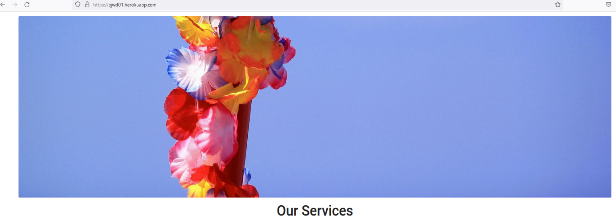
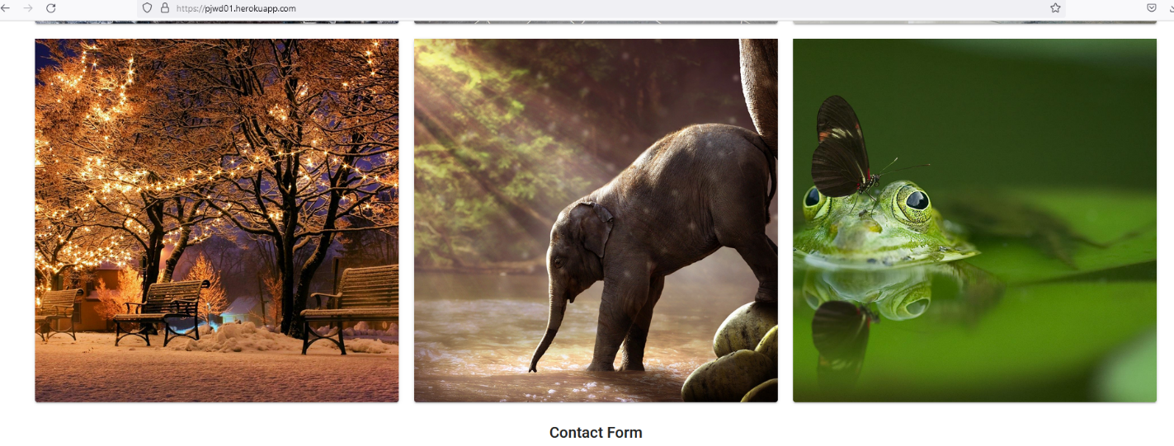
Screenshots of web application
The top picture is coming from the static folder
Pictures are coming from Cloudinary API

Slide 8
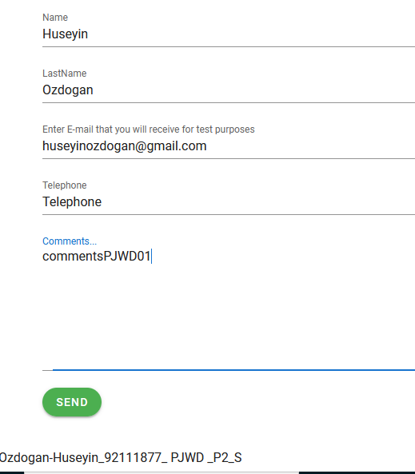
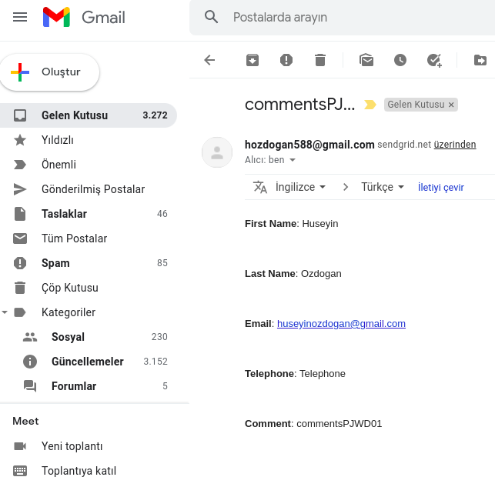
Screenshots of web application(cont.)
Contact form to send email via SendGrid API
Received mail

Slide 9
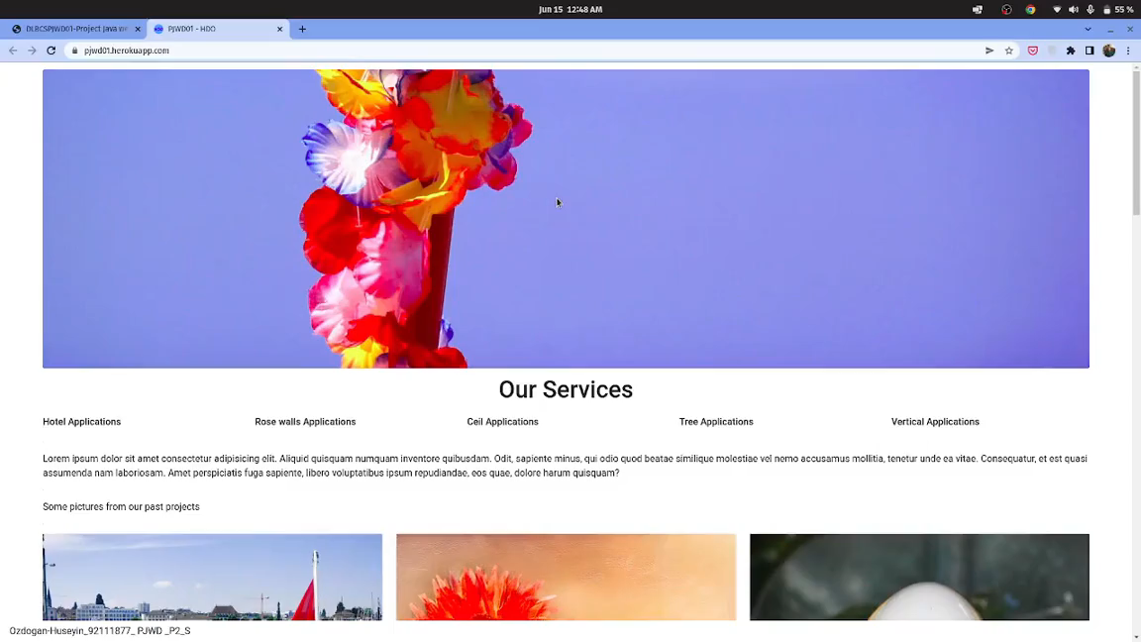
Video of project(2min)

Slide 10
Thank you

